Slide 1
It’s Hard To Be A Sentence!
Class Project

Slide 2
Our Project Based Learning Activity
Project Based Learning (PBL) is a learning method were you learn by creating a project.
Our project will be creating an e-book together.
We are going to learn more about the sentence by creating an e-book, in the same way that the author of It’s Hard To Be A Verb! teaches us about verbs by creating a story related to verbs.
For a PBL, it is very important to be creative and to use our critical thinking skills.

Slide 3
How are we going to create an e-book?
We are going to design a story about the sentence.
Each student is going to create one page of the story.
The teacher will scan each page and place it in a program that creates e-books in the computer. The program can be downloaded free at www.blurb.com
Each student will make a two-paragraph presentation about the page that she or he created.
We are going to read-aloud the e-book with the third grade students from the Luis Muñoz Rivera Elementary School.

Slide 4
Day 1: Introduction and Story Design
On day 1, we will introduce the PBL, so everyone can understand what we are going to do.
On day 1, we will also design the story and assign a page to each student.
  We need to design a story that is based in the following information:
    What is a sentence?
    What are some characteristics of a sentence?
    What are the parts of a sentence?
    What are the kinds of sentences?
Our story is titled It’s Hard To Be A Sentence!
Homework: we are going to search in the internet images for visualizing the two characters of the story.

Slide 5


Example of Character Design
Character: The Sentence

Slide 6
Day 2: Character Design and Page Design
On day 2, we will decide how we are going to visualize the characters of the story.
On day 2, we will also design the page
Homework
  Each student will draw his or her page in pencil.
    The drawing must be proportional to the whole page.
  Each student will decide which media he or she will use to color the page, besides crayons.
    color pencils
    magic markers

Slide 7
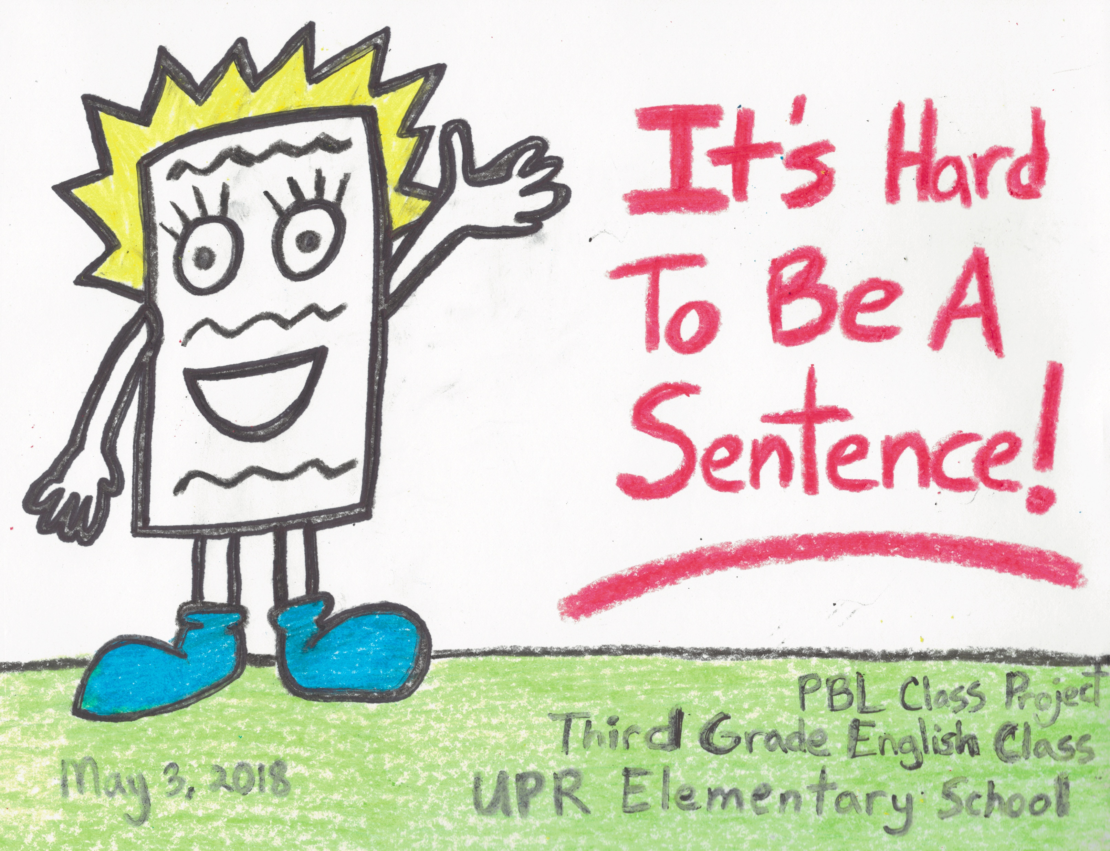
Example of the Character Design and Page Design
Character: The Sentence
Page: The Cover

Slide 8
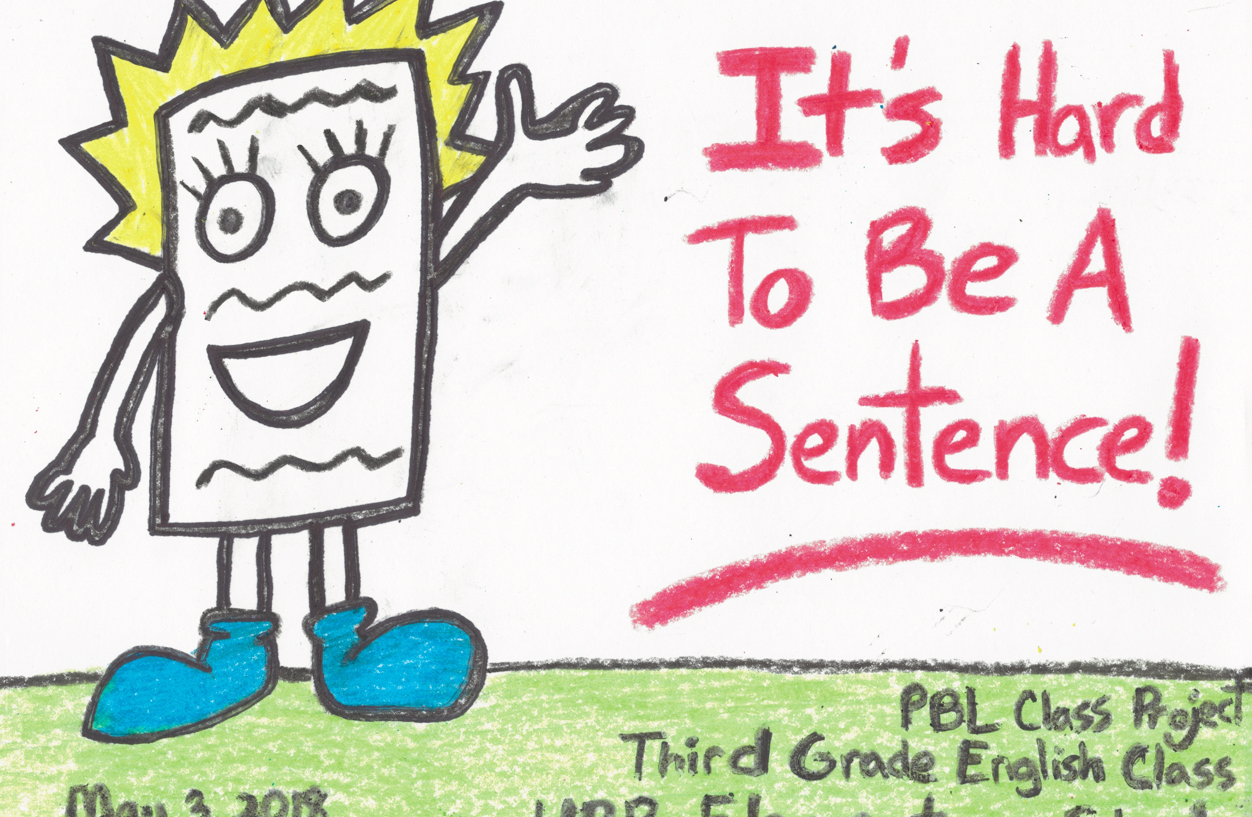
Example of Page Design
The black text is not so clear. This happens when you write the text with the sharpie over the crayons
The black text is clearer. This happens when you write it with the sharpie marker firt, before using the crayons.

Slide 9

Some Design Questions
Will you use a text bubble in each page, or you will just write the text on the page?

Slide 10

Some Design Question
How will I use the crayons on my page? All the pages must be alike, that’s why all pages must be done in crayon and all pages must be written with a black Sharpie.

Slide 11
Day 3: Page Creation
On day 3, the students are going to create his or her page.
  It is important to write the text first and color the images later, because the black Sharpie won’t write over crayons or colored pencils.

Slide 12
Day 4: Page Creation
On day 4, the students will keep creating their pages.
  It is important to use the whole page. It does not need to be covered in color, but all the spaces must be used.

Slide 13
Day 5: Oral Presentation Preparation
On day 5, the students will prepare an oral presentation.
  A graphic organizer will be given to help you prepare your oral presentation.

Slide 14
Day 6: Oral Presentation
On day 6, the students will give a two paragraph oral presentation
  You don’t need to memorize the presentation, you can read it.
  You must include all the information provided in the graphic organizer.

Slide 15
Day 7: Read-Aloud
On day 7, we will read the story aloud to the students from the Luis Muñoz Marín Elementary School in the Art Classroom.
We will reflect on what we have learned through the process of creating a story.
You will share a snack with these students also.

Slide 16
Let’s Enjoy Our PBL!
Let’s get working!

